Slide 1
Introduction to Urology
Prof. Dr. Mete Kilciler
Bahçeşehir University
School of Medicine
Department of Urology

Slide 2
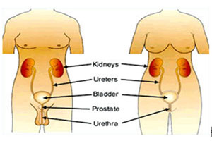
Introduction
Urology is the branch of medicine that deals with the urinary system and the reproductive systems of males.
In Females urology deals with the urinary system.

Slide 3
UROLOGY - SUBGROUPS
UROONCOLOGY
PEDIATRIC UROLOGY
FEMALE UROLOGY
ANDROLOGY
ENDOUROLOGY

Slide 4
URINARY SYSTEM ORGANS
Kidneys (2)
Ureters (2)
Urinary bladder
Urethra

Slide 5
Functions of Urinary System
Regulate electrolytes (K+, Na+, etc)
Regulate pH in blood
Regulate blood pressure
Regulate blood volume
Removing metabolic wastes

Slide 6
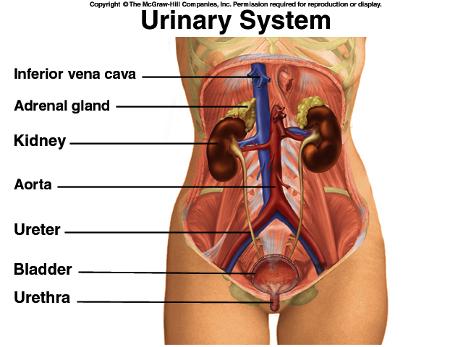

Slide 7
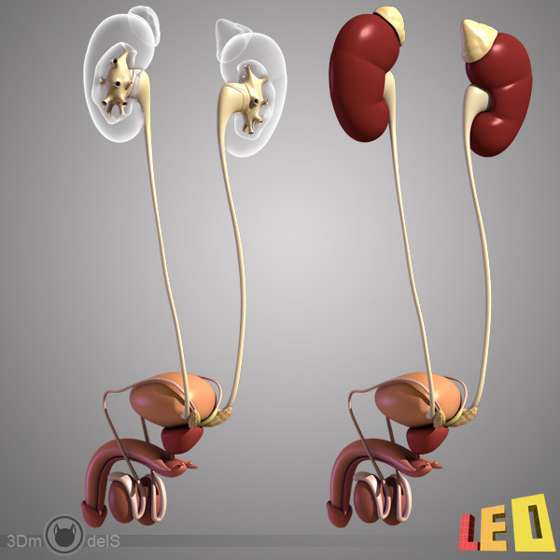

Slide 8
Internal Anatomy of the Kidneys
Renal Cortex
Renal Medulla
Renal pyramids
Renal papillae
Renal columns
Renal Pelvis
With major calyces and minor calyces

Slide 9
Anatomy of Kidney

Slide 10
Relationship of the Kidneys with Vertebra and Ribs
Kidneys are located in the retroperitoneal area
They are below the diaphragm they are not in the thoracic cavity
They are at the level of T12 to L3, so they are at the costal margin, that means they are protected by thoracic ribs

Slide 11
Pyramid of Kidney

Slide 12
KIDNEY ANATOMY
Protected by three connective tissue layers
Renal fascia
Attach to abdominal wall
Adipose capsule
Fat buffering kidney
Renal capsule
Fibrous sac
Protects from trauma and infection

Slide 13
KIDNEY ANATOMY
Nephrons
Functional units of kidney
~1.2 million per kidney
Three main parts
Blood vessels
Renal corpuscle
Renal tubule

Slide 14
RENAL FUNCTION
FILTRATION
EXCRETION
SECRETION

Slide 15
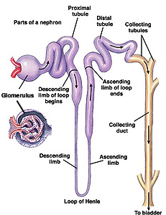
Microscopic Structure of the Kidney and Urine Production

Slide 16
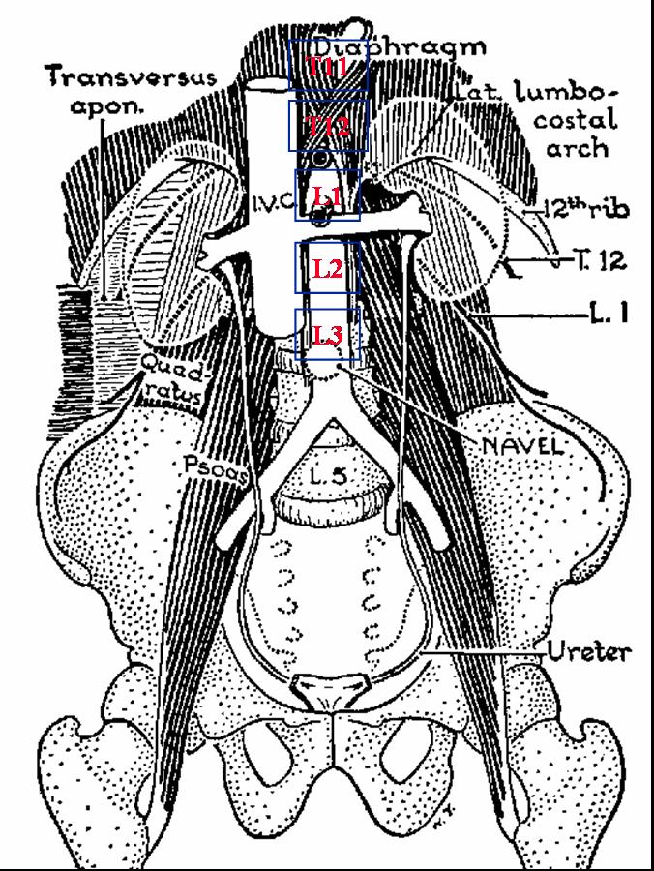
Position of Kidneys
Kidneys lie on the psoas muscle beside the vertebral bodies.
The diaphragm lie behind the upper pole of each kidney.
Therefore they move with breathing
Left is higher than right (liver)
Upper poles at the level T12
Hilum is at the level L1/2
Lower poles at the level L3

Slide 17
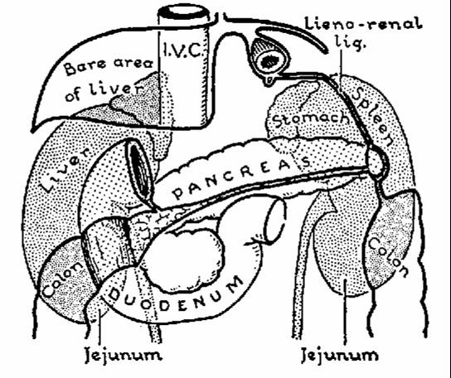
Anterior Relations
Right
Adrenal
Liver
Duodenum
Pancreas
Right colic flexure
Jenunum
Left
Adrenal
Stomach
Spleen
Pancreas
Descending Colon
Jenunum

Slide 18
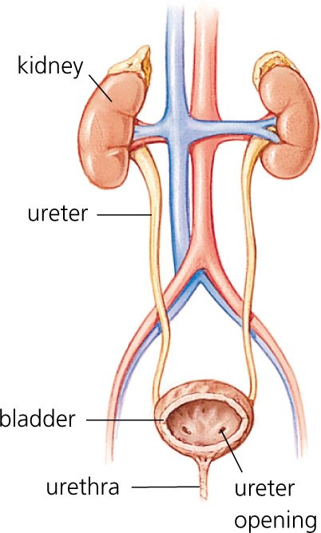
Ureter
Tube between kidney and bladder
Enters bladder at the ureterovesicular junction
Peristaltic motion
Three narrowing areas
Renal ureteropelvic junction
Passage over iliac vessels
Ureterovesicular junction

Slide 19
Ureter - Cross Section
3 layers of tissue
Outer layer
Fibrous tissue
Middle layer
Muscle
Inner layer
Epithelium

Slide 20
Ureters
Small diameter
Easily obstructed or injured by kidney stones

Slide 21
Function of Ureters:
Carry urine from kidneys to urinary bladder by peristaltic motion
Rhythmic contraction of smooth muscle
Enter bladder from below
Pressure from full bladder compresses ureters and prevents backflow

Slide 22
Urine Storage Urine Voiding
URINARY BLADDER
(Reservuar for urine)

Slide 23
Urinary Bladder
Holds approximately 500 cc of urine
Lined with Transitional cells
Body of bladder –detrusor muscle
Neck of bladder
includes the posterior urethral sphincter
internal sphincter
Innervation
Sympathetic
Parasympathetic

Slide 24
Urinary Bladder and Urethra - Female

Slide 25
Urinary Bladder and Prostatic Urethra - Male

Slide 26
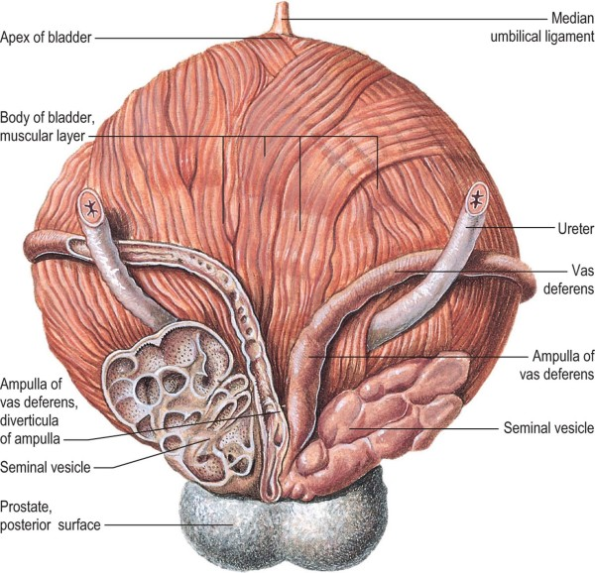
Posterior Aspect of the Urinary Bladder

Slide 27
Structure of Bladder Layers
Outer layer
Loose connective tissue
Middle layer
Smooth muscle and elastic fibres
Inner layer
Lined with transitional epithelium

Slide 28
UV junction has submucosal ureter prevents the back flow of urine

Slide 29
Urethra
Extends from the base of the bladder to the external urethral meatus.
Carry urine from bladder to outside
Anatomical differences
Female: 4cm long
Male: 18cm long

Slide 30
Urethra in Male
Aproximately 18 cm
Posterior and anterior urethra
There are two sphincter – retains urine in bladder
Internal urethral sphincter (smooth muscle, involuntary)
External urethral sphincter (striated muscle, voluntary)

Slide 31
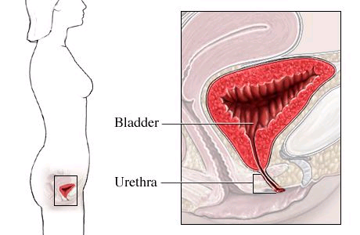
Urethra in Female
Aproximately 4 cm long in females
Bound by connective tissue to anterior wall of vagina
Urethral orifice exits between vaginal orifice and clitoris

Slide 32
Male Bladder and Urethra
Urethra: ~18 cm long
Internal urethral sphincter
External urethral sphincter

Slide 33
Urethra
Its wall has 4 tissue layers:
Tunica mucosa
T. submucosa
T. muscularis
T. serosa

Slide 34
GENITAL SYSTEM ORGANS IN MALE
Penile
Testicles (2)
Prostate
Vesicle Seminalis
Cowper Glands

Slide 35
Penile
Dual function
Copulation
Urination
Urethra
Tube carries urine and semen
Opens at the tip of the glans
Notes:
Penis
Dual function
Copulation
Urination
The urethra, the tube that carries urine and also semen, opens at the tip of the glans
The glans is naturally covered or protected by elongated penile skin – foreskin, which may be retracted to expose the glans.
Many men have had the foreskin removed - circumcision

Slide 36
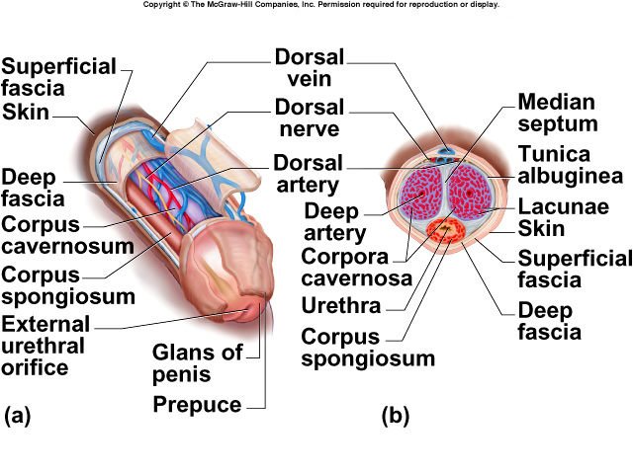
Anatomy of the Penis

Slide 37
Male Inguinal & Scrotal Region

Slide 38
Male Duct System: posterior view

Slide 39
Accessory Glands
Seminal vesicles
posterior to bladder
empty into ejaculatory duct
Prostate gland
below bladder, surrounds urethra and ejaculatory duct
2 x 4 x 3 cm
Bulbourethral glands
near bulb of penis
empty into penile urethra
lubricating fluid
Notes:
Pre-ejaculate

Slide 40
Penis
Consists of 3 cylindrical bodies of erectile tissue
single corpus spongiosum along ventral side of penis
encloses penile urethra
paired corpora cavernosa
each crus attaches to pubic arch & is covered with ischiocavernosus muscle

Slide 41
Testicles
Testicles have two functions
Formation of spermatozoa
Secretion of the male sex hormone - testosterone

Slide 42
Testis and Associated Structures
Oval organ, 4 cm long x 2.5 cm in diameter
Tunica albuginea: white fibrous capsule
Tunica vaginalis:

Slide 43
Vas deferens (ductus deferens)
İt is a kind of tube
Carry sperm from testicles to verumontanum
Notes:
Firm tubular structure passes upward through the inguinal canal to enter the abdominal cavity behind the peritoneum.
It then extends downward toward the base of the bladder.

Slide 44
Seminal Vesicles
It acts as a reservoir for testicular secretions
The tract is continued called the ejaculatory duct
Passes through the prostate gland and enters into the urethra
Notes:
Seminal vesicles
An out-pouch of the vas deference is the seminal vesicle. It acts as a reservoir for testicular secretions.
The tract is continued called the ejaculatory duct –
Passes through the prostate gland and enters into the urethra

Slide 45
Accessory glands
Prostate gland
Location:
below the neck of the bladder
Surrounds the urethra
Function:
Secrets chemicals to help spermatozoa
Notes:
Accessory glands
Prostate gland
Lies just below the neck of the bladder. It surrounds the urethra and is traversed by the ejaculatory duct
This gland produces a secretion that is chemically and physiologically suitable to the needs of the spermatozoa in their passage from the testes
Cowper’s gland / bulbourethral gland (bul-bo-urethral)
Lies below the prostate within the posterior aspect of the urethra
This gland empties its secretions in to the urethra during ejaculation, providing lubrication.

Slide 46
Accessory glands
Cowper’s gland / bulbourethral gland
Location
Below the prostate
Function
Lubrication for sperm
Notes:
(bul-bo-urethral)

