Slide 1
URINARY TRACT TRAUMA
PROF. DR. METE KİLCİLER
DEPARTMENT OF UROLOGY,
SCHOOL OF MEDICINE,
BAHÇEŞEHİR UNIVERSITY

Slide 2
Renal Trauma

Slide 3
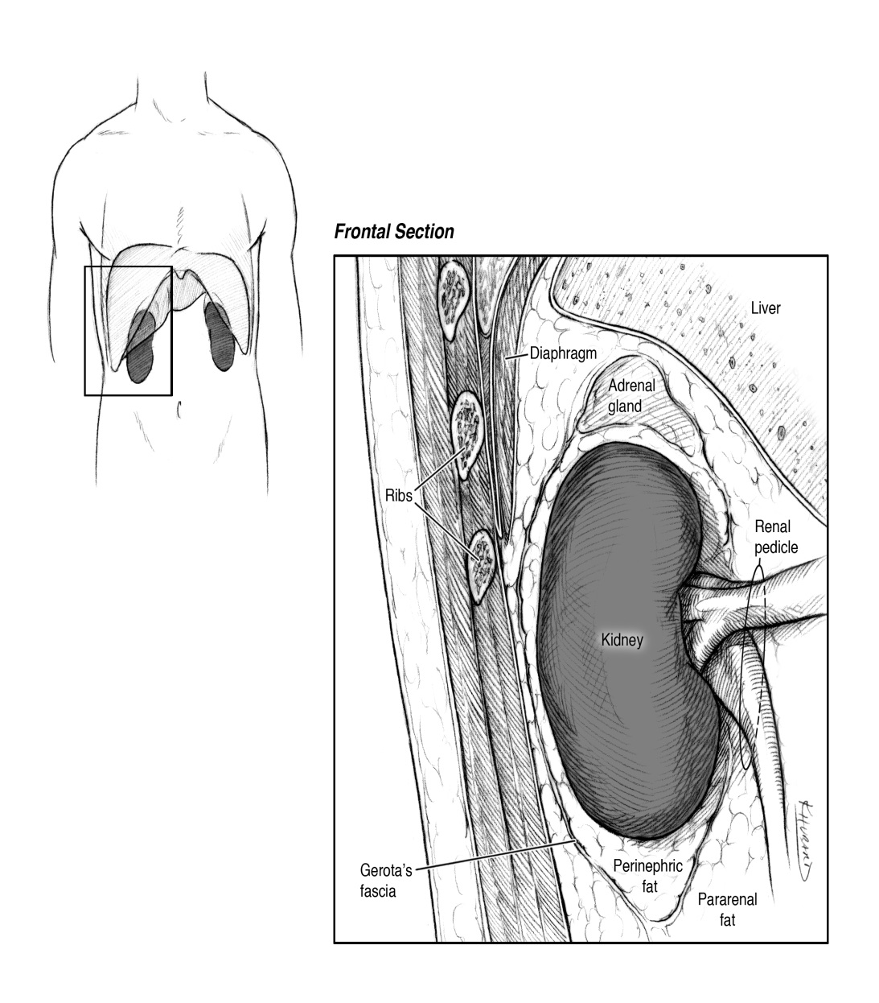
Renal Anatomy
Retroperitoneal
Upper poles protected by ribs so lower poles more commonly injured
Right kidney inferior to left and more commonly injured

Slide 4
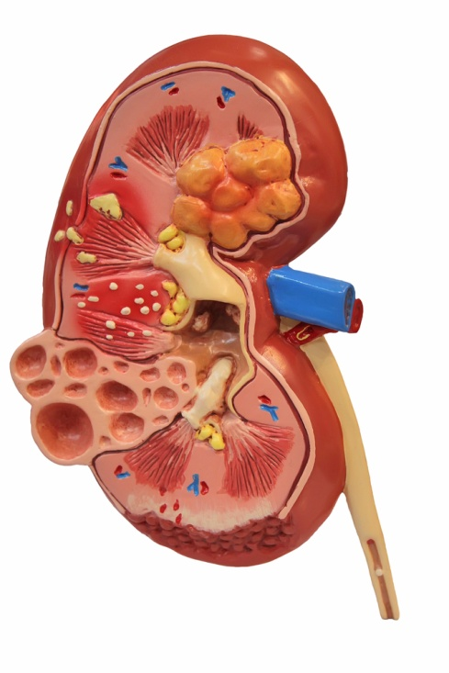
Renal Trauma
Occurs in 8-10% of patients with abdominal trauma
Accounts for 50% of all GU trauma
Notes:
Blunt mechanism is the cause of 70-80% of all traumatic injuries to the kidney
Co-existing injury will occur in 14-34% of cases
Direct blow to back, flank, upper abdomen
Suspect in Fx of 10th - 12th ribs or T₁₂, L₁, L₂
Acceleration/Deceleration
Shearing of renal artery/vein

Slide 5
Renal Trauma
10% of abdominal injuries involve the kidneys
Renal trauma is the most common GU injury—65% of GU injuries
Mechanism
80-95% due to blunt force— falls, assaults, sporting events

Slide 6
When are you concerned about renal injuries?
Mechanism of Injury
Penetrating injuries of abdomen, back or flank
Deceleration injuries
Physical exam
Tenderness of abdomen or flank
Echymosis of abdomen or flank
X-ray
Fractures of lower ribs, thoraco-lumbar spine

Slide 7
Mechanism of Injury - Blunt
Suspect some type of renal injury if fractures of the posterior ribs or lumbar vertebrae are present
Acceleration -Deceleration forces may cause damage to the renal vasculature

Slide 8
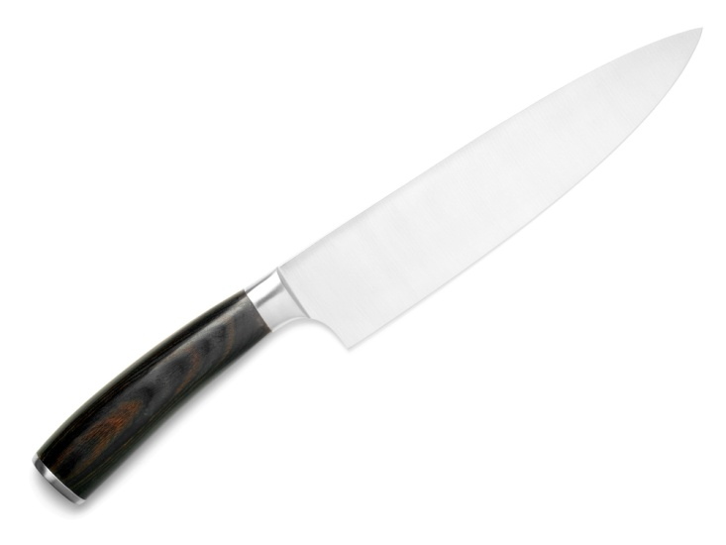
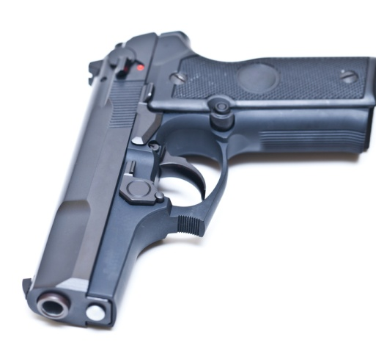
Mechanisms of Injury - Penetrating
High velocity: Gun shot wound
Low velocity: Knife wound
Notes:
Image is of GSW to kidney
Penetrating – GSW most common cause of urethral injury (5-15% of GSW have GU injury); 95% of urethral injuries have an associated abdominal injury.
Penetrating injuries can cause damage by either direct contact or by shock waves from bullets.
Low velocity (i.e. knife, ice pick)
Injury/impalement usually limited to depth and path of weapon
injury usually limited to area near penetration
Medium velocity (i.e. handgun, shotgun)
Bullet path can be difficult to ascertain if redirected
greater external soft tissue injury
High velocity (i.e. high power hunting rifle or military weapon)
energy waves and cavitation occur
Damage can be difficult to ascertain

Slide 9
When are you concerned about renal injuries?
Hematuria—over 95% of patients with renal trauma DEGREE OF HEMATURIA DOES NOT CORRELATE WITH THE SEVERITY OF THE INJURY
25% of patients with gross hematuria have minor injuries
40% of the most serious renal injuries do not have any hematuria

Slide 10
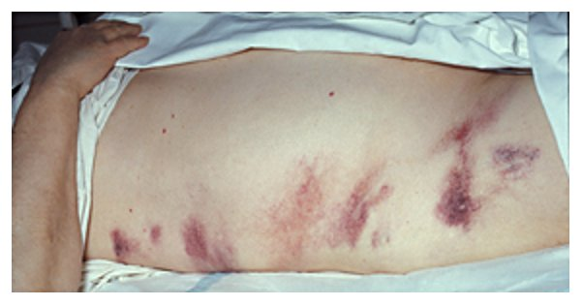
Physical Assessment
Inspection
Palpation
Gray Turner’s Sign
Percussion
Notes:
Your examination of the patient will include inspecting for the following:
Bruising, ecchymosis, bleeding on abdomen, flank, pelvic and perineal areas
Abdomen: Flat or distended
Any signs of external injury including complex, open pelvis fractures; number of GSW or stabbing; impaled objects, Seat belt injury (from blunt trauma), Gunshot or stab wounds (from penetrating trauma)
Grey Turner’s sign – ecchymosis over the posterior aspect of the eleventh or twelfth rib or the flank may indicate renal trauma or retroperitoneal bleeding
Percussion of abdomen and flank area for hyerpressonance and dullness.
Hyperresonance indicates air
Dullness indicates fluid accumulation
Percussion tenderness constitutes a peritoneal sign and mandates further evaluation.

Slide 11
When is Imaging Indicated ?
Penetrating trauma
Pediatric trauma
Deceleration injury
Adult blunt trauma with hematuria

Slide 12
Imaging techniques
Contrast enhanced CT—the best test, up to 98% accurate, not great for renal vein injuries
IVP
Contrast Enhanced Ultrasound
MRI

Slide 13
Why is CT the Best Imaging Study?
Accurate staging
Non-invasive
Detects associated injuries
Rapid
Need contrast

Slide 14
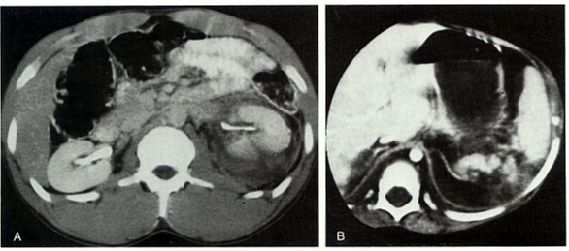

Slide 15
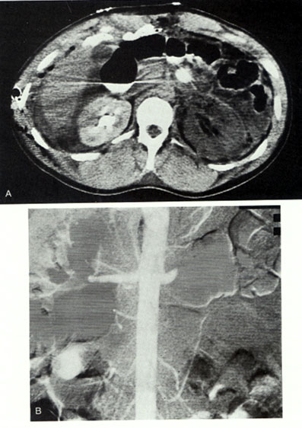

Slide 16
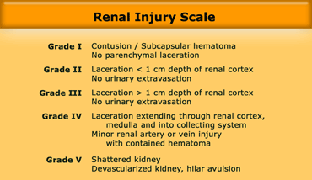
AAST Kidney Injury Severity Scale American Association for the Surgery of Trauma

Slide 17
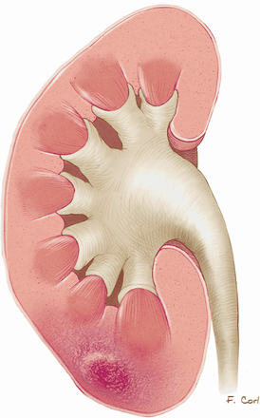
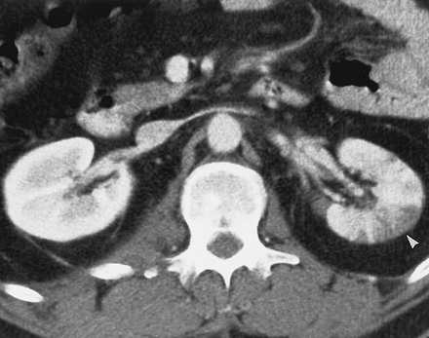
Grade I-Renal contusion

Slide 18
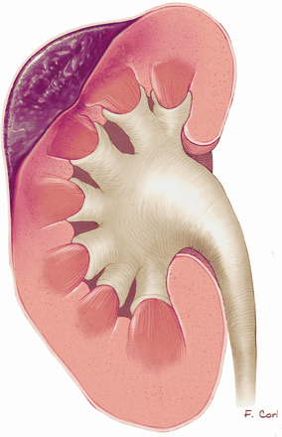
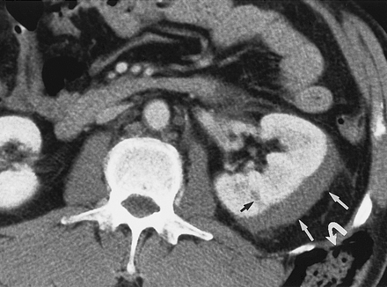
Grade I-Subcapsular Hematoma

Slide 19
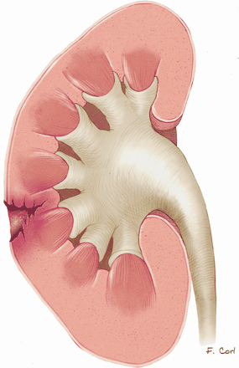
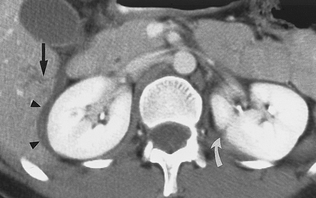
Grade II-Small Cortical Laceration

Slide 20
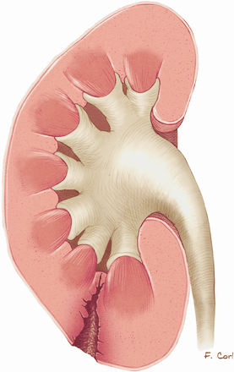
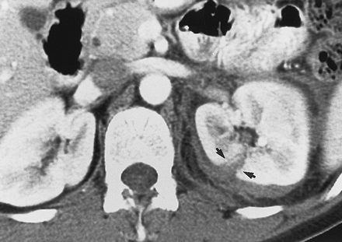
Grade III-Major Renal Laceration

Slide 21
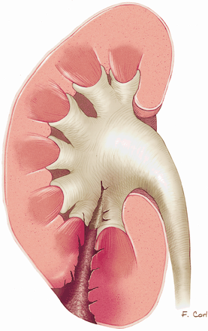
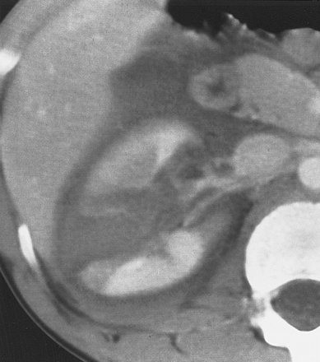
Grade IV-Major Laceration involving Collecting System

Slide 22
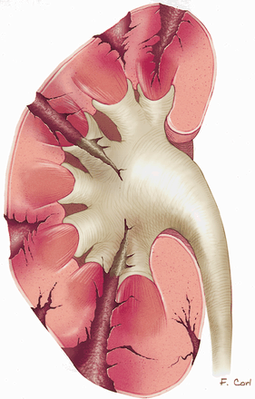
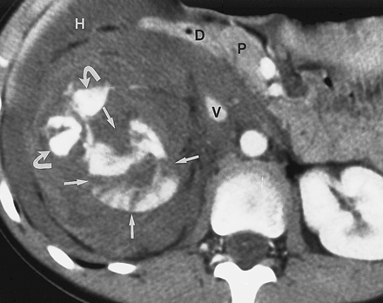
Grade IV- Multiple Renal Lacerations

Slide 23
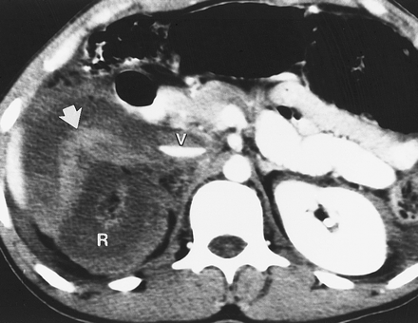
Grade IV-“Shattered” Kidney

Slide 24
Grade V- Avascular Left Kidney

Slide 25
Blunt Injury
Only 1-2% of injuries involve the pedicle,
Renal injuries are more common, result from deceleration tend to be partial tears
Renal lacerations account for 2-4% of all renal injuries, diagnosed by CT

Slide 26
Management of Renal Injuries
Grade I—home
Grade II-IV—admit, observe
Grade V—observe, vascular repair/stent, or nephrectomy
absolute indications for surgery are:
persistent renal bleeding with hemodynamic instability,
active extravasation of IV contrast,
expanding or pulsatile perirenal hematoma
suggesting Grade V vascular injury

Slide 27
Blunt Injury
Surgical repair controversial
Minor renal lacerations/contusions managed expectantly

Slide 28
Penetrating Injuries
Hematuria is of no consequence as all patients need CT, most will need surgery

Slide 29
Complications of Renal Injuries
Mortality 3%
Complications
First six weeks
Hemorrhage/shock
Sepsis/abscess
ATN
Late
Renovascular HTN 4%

Slide 30
Renal Trauma Complications
Major Trauma
Abscess/urinomas
Sepsis
Fistula
Renal atrophy
Rhabdomyolysis/myoglobinuria
Renal HTN
Renal Failure
Sepsis
Decreased H/H
Expanding perirenal mass
Hemodynamic instability
Notes:
Blunt trauma cases usually have more issues than penetrating cases because the penetrating cases have had a surgical intervention and structures have been visualized
Examples of common complications seen with minor renal trauma are the following.
5% require surgical exploration due to an expanding perirenal mass or hemodynamic instability
There are rare incidences of sepsis, loss of renal function, and hemorrhage.
Examples of some common complications seen with major renal trauma are:
Abscesses to pancreas and small bowel.
Sepsis from infections, abscesses, UTI, polynephritis
Fistulas to almost any part of the abdomen or pelvis
Urinomas: Grade III and IV renal injuries are associated with urinomas (a cyst filled with urine). They are caused by the extravasation of urine during the injury. Percutaneous drainage is essential to prevent further injury to the renal collecting ducts. Usually during surgery for Grade IV and V injuries, drainage of any urinomas is done. Persistent extravasation of urine is a problems that can result in sepsis.
Renal atrophy, Urethral stricture and obstructive hydronephrosis and loss of renal function are all complications that can occur. They are rare but they can occur up to 4 weeks after injury.
Rhabdomyolysis/myoglobinuria is a complication that can occur with burns, orthopedic/soft tissue damage, crush injuries, patients who were immobile for long periods of time. It will be discussed more in detail in the burn lecture. It is discussed briefly here since it can contribute to renal failure.

Slide 31
Ureteral Trauma

Slide 32
Ureteral Anatomy
Thin, mobile tubes running between renal pelvis and posterior superior angle of bladder
Retroperitoneal in abdomen
Protected from injury by size and mobility

Slide 33
Ureteral Trauma
Accounts for 1% of urologic trauma
Penetrating (usually Gun Shot Wound) trauma to abd, back, flank
Most commonly iatrogenic following GU, gynecologic, vascular or colorectal surgery

Slide 34
Diagnosis/Treatment
Usually made by finding urine in surgical wounds/dressings or the development of a urinoma
Contrast CT or bolus IVP can Show the injury
Retrograde pyelography will aid in diagnosis
All injuries need surgical repair

Slide 35
IMAGING FOR URETERAL INJURIES
Most injuries diagnosed during laparotomy
Contrast CT—most common findings are extravasation of contrast into medial perirenal space and absence of contrast in distal ureter if transected
IVP
Retrograde pyelogram

Slide 36
Delayed CT images showing extravasation of urine from ureteral injury

Slide 37
American Association for the Surgery of Trauma (AAST)
Ureter Injury Severity Scale
Grade |  | Injury Description
I | Hematoma | Contusion or hematoma without devascularization
II | Laceration | < 50 % transection
III | Laceration | > 50 % transection
IV | Laceration | Complete transection with 2 cm devascularization
V | Laceration | Avulsion of renal hilum which devascularizes kidney
Notes:
92% of patients require surgery due to associated injuries. It is not the ureteral injury which leads them initially to the OR. Frequently the ureter injury is an incidental finding when other injuries are being repaired.
Repair – uretero-ureterostomy; transuretero-ureterostomy, reimplantation into bladder.
Goal – preserve renal function and restore continuity of the collecting system.
Delayed diagnosis can result in loss of renal function.

Slide 38
Ureter Trauma Management
Ureterostomy
Irrigation and Drainage
Antibiotics
Stenting
Notes:
Stab wound and iatrogenic traumatic injuries are taken to the Operating Room due to need for minor debridement and suture approximation
GSW and blast injuries can cause microvascular deficits and produce delayed necrosis and extravasation
Ureter transection requires surgical repair and ureterostomy to divert urine flow, wound irrigation, competent drainage and prophylactic antibiotic
Internal stenting is usually done for those injuries that have the potential to be complicated by contamination, ischemia or associated vascular injury

Slide 39
Complications of Ureter Trauma
Missed injuries usually manifest by
Fever
Flank mass or discomfort
Ileus
Leukocytosis
Lethargy
Urinary fistula to skin or vagina
Sepsis
Wound infection
Complications
Fistula
Stricture or ureteral obstruction
Retroperitoneal urinoma
Infection
Obstructive hydronephrosis
Notes:
Stricture or obstruction causes hydronephrosis. This can be determined with a follow-up IVP at 6 weeks post-op and again at 3 months.
39

Slide 40
Urinary Bladder Trauma

Slide 41
Bladder Anatomy
Lies within pelvis when empty, can reach umbilicus when full
Consists of 3 muscle layers
Blood supplied from int. iliac artery, nerve supply from lumbar and sacral plexus
Bladder trauma usually associated with severe injuries, mortality 22-44%

Slide 42
Urinary Bladder Anatomy
Empty bladder is a pelvic organ and protected by pelvic bones
With distention, becomes an abdominal organ and more prone to injury due to direct trauma
Peritoneum covers superior surface of bladder

Slide 43
Pathophysiology
Intraperitoneal rupture usually from blunt trauma in patients with a full bladder
Clinically will see lower abdominal pain, inability to urinate, blood at meatus

Slide 44
Pathophysiology
Can rupture in or outside of peritoneum, or both
Extraperitoneal rupture usually from pelvic fracture with laceration of bladder, but may occur with blunt trauma

Slide 45
Urinary Bladder Trauma
Mechanisms of Injury
Blunt—up to 85% of cases
10% of patients with pelvic fractures will have bladder injuries
Penetrating—up to 15% of cases
Surgical/Cystoscopy

Slide 46
When are you concerned about a bladder injury?
Clinical Presentation
Suprapubic pain
Difficulty voiding
Hematuria
X-ray
Widened symphysis pubis is stongest predictor
Pelvic, sacrum, iliac, ramus fractures

Slide 47
Lab
Gross hematuria indicative of urologic injury
Clear urine and no pelvic fracture virtually eliminates possibility of bladder rupture
98% of patients with bladder rupture have gross hematuria

Slide 48
Diagnostic Studies
Retrograde cystogram
Retrograde CT cystogram
Either one follows urethogram if concern for urethral injury exists

Slide 49
Indications for Cystography
Blunt Trauma in close proximity to bladder with gross hematuria
Pelvic fractures from blunt mechanism with any degree of hematuria
Penetrating Trauma in proximity to the bladder
Penetrating trauma with any degree of hematuria

Slide 50
Retrograde Cystogram
Place a foley catheter, fill the bladder with the contrast and than clamped and AP film taken
Then empty bladder and take post-evacuation film
If extraperitoneal perforation, will see contrast in area of pubic symphysis,intraperitoneal perforation will outline abdominal contents

Slide 51
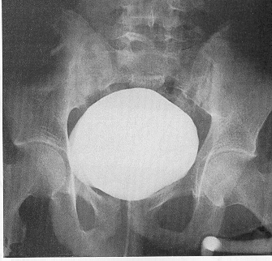
Retrograde Cystogram--Normal

Slide 52
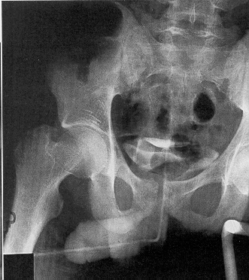
Retrograde Cystogram—Post-Void, Normal

Slide 53
Extraperitoneal Bladder Rupture
50-90% of bladder ruptures
Usually associated with pelvic fracture
Usually treated with urethral/suprapubic catheter

Slide 54
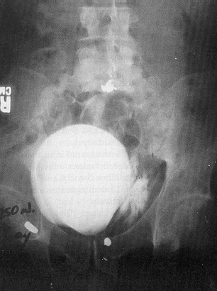
Retrograde Cystogram—Extraperitoneal Rupture

Slide 55
Retrograde Cystogram—Extraperitoneal Rupture

Slide 56
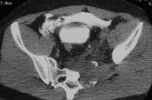
CT Cystogram—Extraperitoneal Rupture

Slide 57
CT Cystogram with Extraperitoneal Rupture

Slide 58
CT Cystogram with Extraperitoneal Rupture with Sagittal View

Slide 59
Intraperitoneal Bladder Rupture
15-35% of bladder ruptures
Bladder usually distended at time of trauma
Historically treated surgically
Conservative management possible

Slide 60
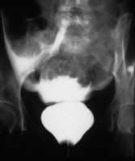
Retrograde Cystogram—Intraperitoneal Rupture

Slide 61
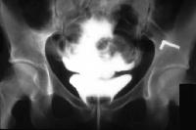
Retrograde Cystogram—Intraperitoneal Rupture

Slide 62
Bladder Injury Scale American Association for the Surgery of Trauma
Grade |  | Injury Description
I | Hematoma | Contusion, intramural hematoma
 | Laceration | Partial thickness
II | Laceration | Extraperitoneal bladder wall laceration < 2 cm
III | Laceration | Extraperitoneal (> 2 cm) or intraperitoneal ( < 2 cm) bladder wall lacerations
IV | Laceration | Intraperitoneal (> 2 cm) bladder wall lacerations
V | Laceration | Intra or extraperitoneal bladder wall laceration extending into the bladder neck or urethral orifice (trigone)
Notes:
Bladder contusion – catheter drainage until gross hematuria has subsided
Penetrating: managed according to the type and site of injury
With exception of large or stellate lacerations, intraperitoneal bladder injuries are managed by foley catheter drainage
Extraperitoneal bladder is usually managed non-operatively. A cystogram should be repeated later to determine closure of the rupture. A supra pubic foley catheter is adequate management for urine removal and results in few days of catherization in comparison with management with a suprapubic tube. The patient is also given a repeat cystogram to ensure closure of the rupture.
Intraperitoneal bladder rupture requires operative repair and drainage of the extravasted urine. Operative management usually involves over sewing the large, stellate tears in the dome of the bladder due to the sudden rise in the pressure within a full bladder. Urine is temporarily drained via a foley catheter drainage system.

Slide 63
Treatment
If no extravasation treat with or without Foley drainage
Extraperitoneal ruptures treated with Foley drainage for 7 to 15 days with 20Fr. or greater sized catheter

Slide 64
Treatment
Surgical repair if rupture involves bladder neck or proximal urethra
Intraperitoneal ruptures always require surgical repair
Children 77%
Increased Bun/Cr
Potentially lethal

Slide 65
Complications of Bladder Trauma
Mortality associated with bladder injury is reported to be 11-44%. Higher mortality associated with intraperitoneal rupture.
Death from a bladder injury is usually attributed to hemorrhage, sepsis or anorectal injury.
Notes:
Death from a bladder injury is usually attributed to hemorrhage, sepsis and anorectal injury. These causes of death are usually associated with missed injuries or an appreciation of how sick the patient was either due to their age, an underlying medical condition or their ability to compensate.
Catheter care/perineal care prevents infection from the indwelling and suprapubic catheters. Adequate fluid intake to maintain urine output also prevents bladder infections. Antispasmodic medication may help should the patient experience bladder spasms.
Catheter care/perineal care prevents infection from the indwelling and suprapubic catheters. Adequate fluid intake to maintain urine output also prevents bladder infections. Antispasmodic medication may help should the patient experience bladder spasms.

Slide 66
Urethral Injuries

Slide 67
Urethral Anatomy
Anatomy based on relation to urogenital diaphragm
Posterior
Prostatic
Membranous
Anterior
Bulbous
Penile

Slide 68
Urethral Injuries
10% of all injuries to GU system
Potentially most debilitating GU injury due to complications
Rare in women
Mechanism of Injury
Blunt trauma such as mvc, bike accidents, straddle mechanisms
Often associated with pelvic fractures
Rarely penetrating trauma
Occasionally iatrogenic

Slide 69
Urethral Trauma Mechanism of Injury
Posterior injury usually accompanies pelvic fractures
Trauma to anterior urethra usually isolated
Trauma to posterior urethra usually co-exists with damage to other structures
Sudden deceleration injuries (bladder shears off urethra)
Notes:
Posterior urethral injuries are most often associated with pelvic fractures, although anterior urethra injuries are associated with straddle, GSW/penetrating, industrial and self-inflicted instrumentation events.
Straddle injury was originally described in horseback riders and is the result of direct trauma. Urethral injury is a known complication.
AP radiograph of the pelvis. This shows bilateral inferior and superior pubic rami fractures
Bilateral superior and inferior rami fractures are known mechanism of injury.
Other mechanisms include:
GSW
Blunt force
Impalement
Assaults
Self-inflicted injuries
Prostatic urethral trauma is occasionally encountered in preadolescent males because of their immature prostatic volume.
Associated injuries include:
Pelvic fracture
Bladder neck injuries
Vaginal injuries

Slide 70
Signs and Symptoms of Urethral Trauma
Suprapubic pain
Urge to urinate but are unable
Hematuria (may be microscopic)
Blood at external meatus
Perineal butterfly eritem
Scrotal Hematoma
Rebound tenderness
Abdominal wall muscle rigidity
Displaced prostate gland during rectal exam
Notes:
Urinary catheters should not be passed if these are present.
The way to determine if the prostate has been displaced is to perform a rectal exam. A rectal exam should be performed before passing a urinary catheter in a patient whose urethra may be disrupted, displaced bladder and who has a fistula.
The rectal exam in a male is looking for a high-riding or palpable, boggy prostrate in addition to occult/frank blood.

Slide 71
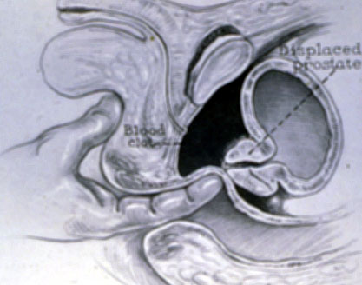

Slide 72
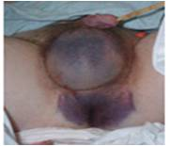
Physical Assessment
Perineal area
Bleeding from urinary meatus
Butterfly pattern ecchymosis
Scrotal edema
Notes:
Signs and symptoms of GU trauma:
Signs of urinary meatus tear. Bleeding indicates urethral injury. DO NOT place a foley catheter. Consultation with a Urology Specialist will probably be necessary.
Evidence of an open pelvis fracture. If the patient is female be sure to check for vaginal injury.
Examine the perineal area for lacerations, hematomas, swelling, etc. A butterfly pattern can possibly indicate classic urethral, pelvis, or retroperitoneal injury. Diffuse perineal bruising can be a late sign of a pubic rami/symphysis diastases fracture.
Examine the prostate. A boggy, palpable, or displaced prostate may indicate urethral injury.

Slide 73
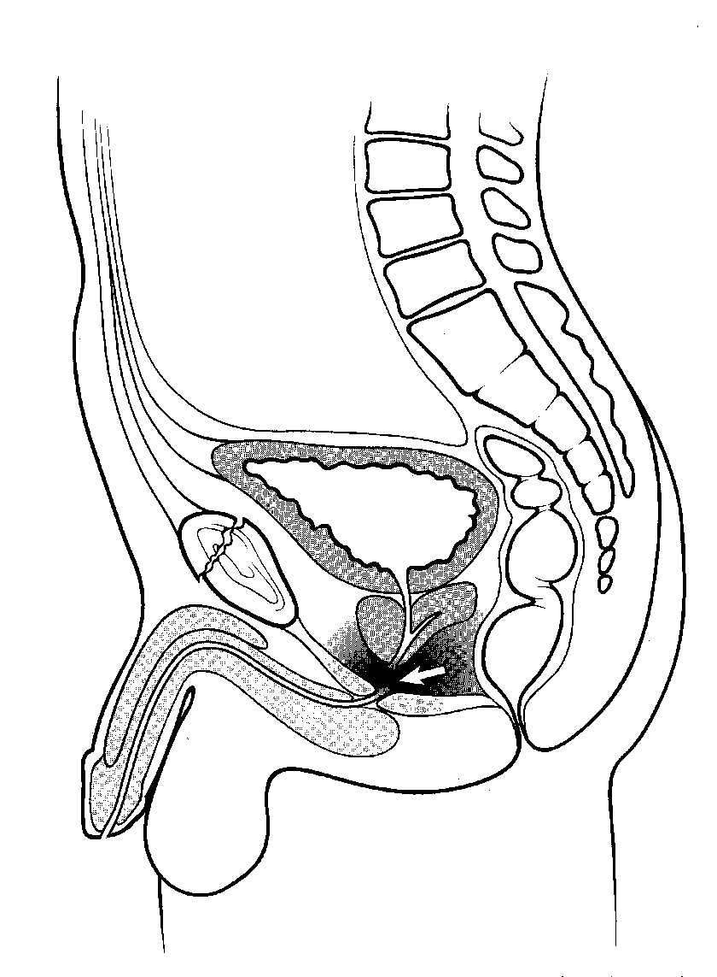
Posterior Urethral Injuries
80-90% occur in combination with pelvic fracture
10-25% of pelvic ring fractures disrupt posterior urethra as puboprostatic ligaments are torn or stretched
Associated with bladder injuries and vaginal lacerations

Slide 74
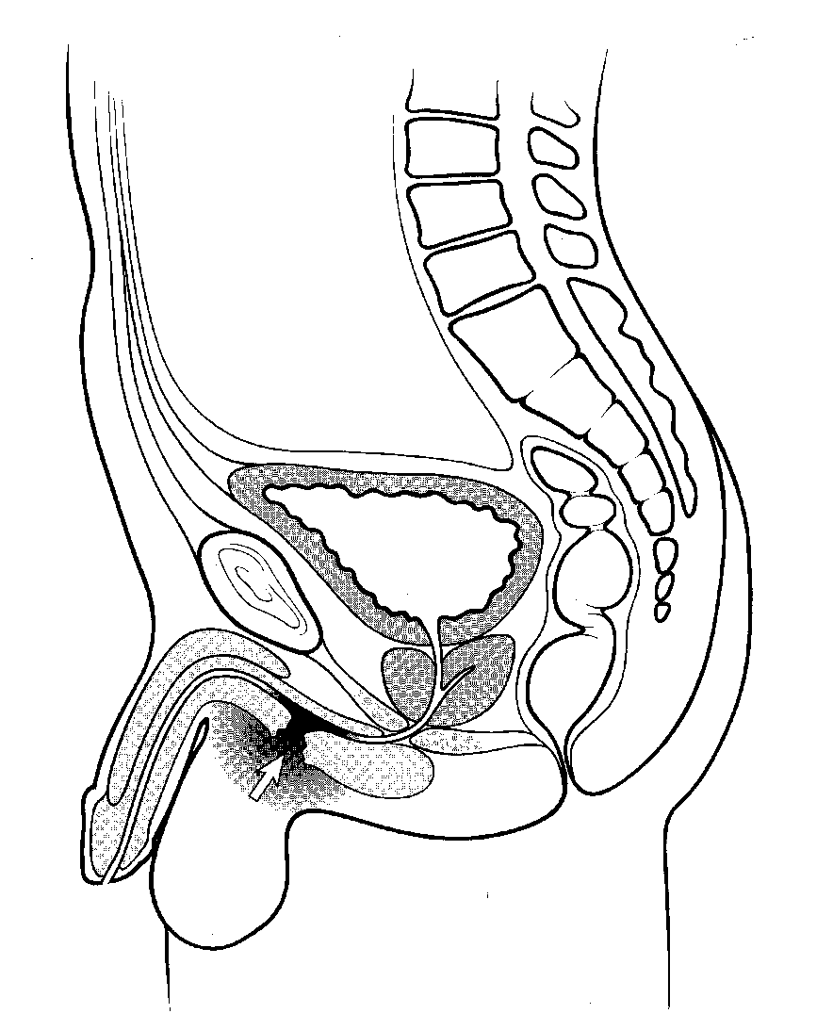
Anterior Urethral Disruption
Usually due to direct blunt force trauma such as saddle injury
Does not cause high riding prostate as injury is below the urogenital diaphragm
Ureteral injury present in 10-38% of penile fractures

Slide 75
Urethral Injury Scale American Association for the Surgery of Trauma
Grade |  | Injury Description
I | Contusion | Blood at urinary meatus, urethrography normal
II | Stretch Injury | Elongation of urethra without extravasation on urethrography
III | Partial Disruption | Extravasation of urethrographic contrast medium at injury site, with contrast visualized in the bladder
IV | Complete Disruption | Extravasation of urethrographic contrast medium at injury site without visualization in the bladder, < 2 cm of urethral separation
V | Complete Disruption | Complete transection with > 2 cm urethral separation or extension into the prostrate or vagina
Notes:
This slide discusses the urethral injury scale. We will also discuss some specific injuries such as the anterior and posterior urethral injuries in the next few slides.

Slide 76
Retrograde Urethrogram
Complete disruption—contrast extravasates and none reaches bladder
Partial disruption—contrast extravasates and some reaches bladder

Slide 77
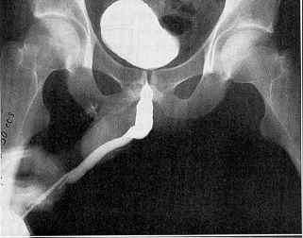
Normal Urethrogram

Slide 78
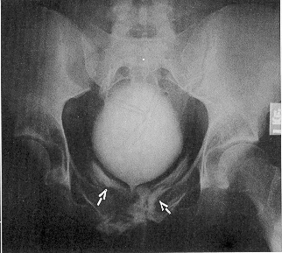
Grade III-Partial Urethral Disruption

Slide 79
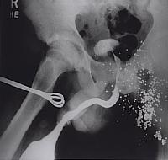
Grade III Partial Urethral Disruption

Slide 80
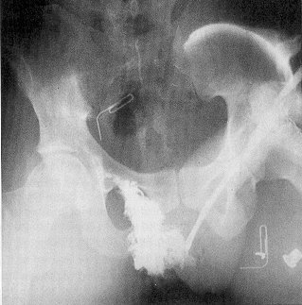
Grade IV or V Complete Urethral Disruption

Slide 81
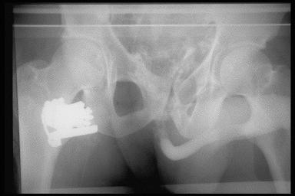
Grade V Complete Urethral Disruption

Slide 82
Urethral Trauma Female
Female urethral trauma usually coexists with vaginal lacerations resulting in a urethrovaginal communication
Delay in diagnosis may result in:
Incontinence - Necrotizing fasciitis, sepsis
Uretero-vaginal fistula
Dyspareunia, recurrent urethritis
Hematuria, cystitis
Notes:
For a female is there is a delay in diagnosis or a missed urethral injury, the delay in diagnosis and treatment can result in these complications

Slide 83
Urethral Trauma Complications
Erectile dysfunction
13-30% of patients with pelvic fracture and urethral distraction injury
Incontinence
Most with significant urethral distraction injury have injury to the external (striated) sphincter, continence is then provided by the bladder neck.
Stricture

Slide 84
Thank You

