Slide 1
HEMATURIA
PROF. DR. METE KİLCİLER
DEPARTMENT OF UROLOGY,
SCHOOL OF MEDICINE,
BAHÇEŞEHİR UNIVERSITY

Slide 2
HEMATURIA
Hematuria is defined as the presence of 5 or more red blood cells (RBCs) per high-power field in fresh centrifuged urine speciment.

Slide 3
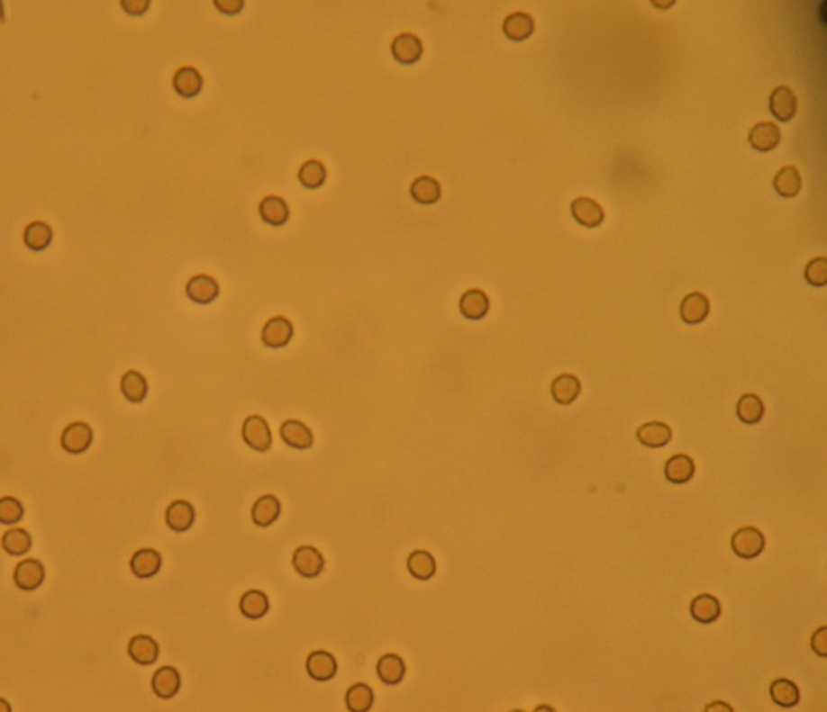
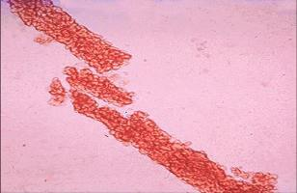
HPF= x 400

Slide 4
Hematuria
Macroscopic or microscopic
Symptomatic or asymptomatic
Transient or persistent
Either isolated or associated with proteinuria and other urinary abnormalities

Slide 5
Hematuria
Transient phenomenon
of little significance
Sign of serious
renal disease

Slide 6
Microscopic Hematuria
Definition > 3-5 RBC/HPF
> 5 RBC/mm³
> 8000 RBC/ml

Slide 7
Causes of Hematuria
Kidney disease
Lesions along the urinary tract
Unrelated conditions to kidney and urinary tract

Slide 8
Glomerular versus extraglomerular bleeding
Urinary finding | Glomerular | Extraglomerular
Red cell casts | May be present | Absent
Red cell morphology | Dysmorphic | Uniform
Proteinuria | May be present | Absent
Clots | Absent | May be present
Color | May be red or brown | May be red

Slide 9
Glomerular vs Extraglomerular Bleeding
Clots never occur in glomerular disease
A three tube test may sometimes be useful
The first few ml – urethral lesions
Midstream urine –
The last few ml urine – lesion of bladder trigone

Slide 10
Charecteristics of Urine
Glomerular: brownish or cola-coloured and may contain RBCs cast, proteinuria
Lower urinary tract: red to pink color urine and may contain clots

Slide 11
Causes of Hematuria
1- Glomerular hematuria :
Thin basement membrane disease (benign familial hematuria)
Alport syndrome
IgA nephropathy
Hemolytic uremic syndrome
Postinfectious glomerulonephritis
Membranoproliferative glomerulonephritis
Lupus nephritis
Anaphylactoid purpura (Henoch-Schönlein purpura).

Slide 12
Causes of Hematuria
2- Nonglomerular hematuria:
Fever
Strenuous exercise
Mechanical trauma (masturbation)
Menstruation
Foreign bodies
Urinary tract infection
Hypercalciuria/urolithiasis
Sickle cell disease/trait
Coagulopathy
Tumors
Drugs/toxins (NSAIDs, anticoagulants, cyclophosphamide, ritonavir, indinavir)
Anatomic abnormalities (hydronephrosis, polycystic kidney disease, vascular malformations)
Hyperuricosuria

Slide 13
Hematuria not representing kidney or urinary tract disorder
Following exercise
Febrile disorders
Gastroenteritis with dehydration
Contamination from external genitalia

Slide 14
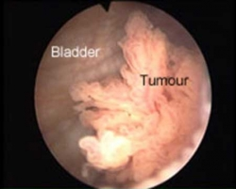
Risk Factors
Male gender
Aged 35 and over
Past or current smoker
Occupational exposure to chemicals
Analgesic abuse
History of gross haematuria
History of urologic disorder or disease
History of irritative voiding symptoms
History of pelvic irradiation
History of chronic urinary tract infections
History of exposure to known carcinogens or chemotherapy
History of chronic indwelling foreign body

Slide 15
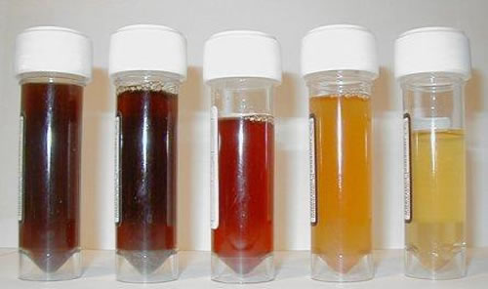
Haematuria
Common presenting symptom of renal tract disorders
Prevalence 0.5 - 6% on population screening

Slide 16
Macroscopic Haematuria

Slide 17
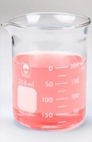
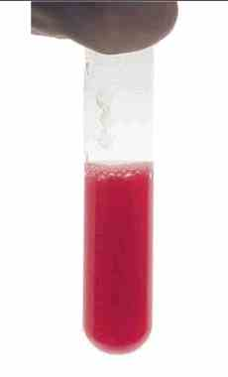
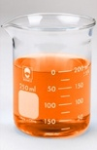
Causes of red or pink urine
Haemoglobinuria
Myoglobinuria
Porphyrins
Urates (pink)
Foods – beetroot, blackberries
Drugs
Rifampicin (orange)
Chloroquine, desferoxamine

Slide 18
Causes of RED urine
Heme-negative (no RBC or Hb)
Heme-positive ( Hb + no RBC)
True Hematuria ( RBC +- Hb)

Slide 19
Causes of Heme-positive ( no RBC but positive Hb)
Hemoglobinuria (As in Hemolytic Anemia)
Myoglobinuria (Resulting from muscle injury or secondary to viral infection, cruch injury, or DIC)

Slide 20
Causes of Heme-negative (no RBC or Hb).
Drugs
Dyes
Metabolites

Slide 21
Red urine without RBCs

Slide 22
Red urine without RBCs

Slide 23
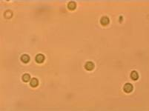
Haematuria - Definition
Urine microscopy
RBC > 5/uL in a fresh uncentrifuged specimen
RBC > 5 -10/high power field in a midstream sample
RBC morphology & presence of casts

Slide 24
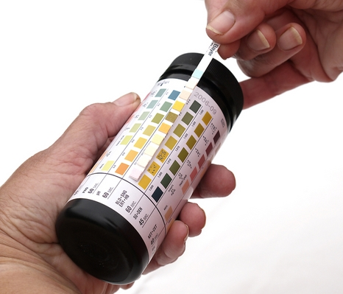
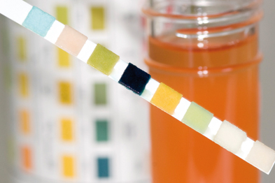
Urine dipstick
Useful screening test
sensitive

Slide 25
Haematuria - Diagnosis
Higher false positives
Do not use urine dipstick to diagnose haematuria

Slide 26
Causes of hematuria
Renal
Malignant renal mass
Benign renal mass
Glomerular bleeding
Structural diseases
Pyelonephritis
Hydronephrosis
Hypercalcinuria / Hyperuricosuria
Renal vein thrombosis
Renal artery embolism
Arteriovenous malformation
Ureteric
Malignancy
Calculi
Strictures
Fibroepithelial polyp
Fistulas
Bladder
Malignancy
Radiation
Cystitis
Prostate/Urethra
Benign prostatic hyperplasia
Prostate carcinoma
Catheterisation
Urethritis

Slide 27
Urologic causes of hematuria
Upper tract
Renal cell carcinoma
Renal calculi
Obstruction/Hydronephrosis
Lower tract
Bladder cancer
BPH
UTI
Urethral Stricture

Slide 28
When to suspect a nephrologic (glomerular) disease?
RBC casts
Proteinuria
Dysmorphic red blood cells
Elevated creatinine

Slide 29
The Approach
Microscopic Hematuria
urine dipstick + ve
repeat urine dipstick -ve w/u ends unless
(several days later) RF for bladder ca
+ve
Gross hematuria microscopy
red cell casts no red cell casts
glomerular hematuria nonglomerular hematuria

Slide 30
The Approach
Glomerular Hematuria
NO protein or +ve protein or
renal insufficiency renal insufficiency
periodic medical follow-up Nephrology referral
monitor for proteinuria or for renal biopsy
renal insufficiency
(q 6-12 months)

Slide 31
The Approach
Nonglomerular Hematuria
CT +ve refer based
(or U/S) on lesion
-ve
urine cytology +ve cystoscopy
-ve
>= 50 or <50 and
RF for bladder Ca or no RF for bladder Ca
gross hematuria
cystoscopy w/u ends (yearly urinalysis)

Slide 32
History and Examination
History
Time course
Infective symptoms
Urinary symptoms
Associated symptoms
Past history
Social history
Family history
Examination
Vital signs
Abdominal
DRE

Slide 33
Urological Referral
All patients with macroscopic haematuria
All patients with symptomatic microscopic haematuria
All patients with asymptomatic microscopic haematuria who are aged 35 and over

Slide 34
Nephrological Referral
Consideration of nephrological referral
Declining GFR
>10ml/min within the previous 5 years
>5ml/min within the last 1 year
Stage 4 or 5 CKD (eGFR <30)
Significant proteinuria
PCR ≥50mg/mmol
ACR ≥30mg/mmol
Isolated haematuria with hypertension who are aged ≤40
Haematuria with coinciding intercurrent infection

Slide 35
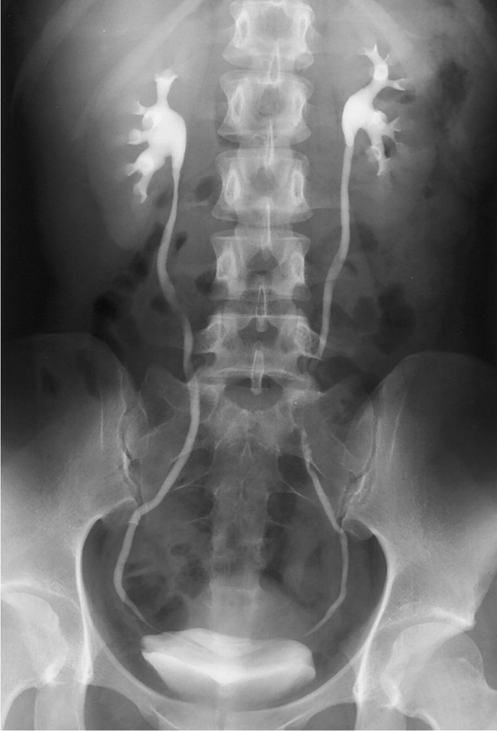
Imaging
CT Urography
Non-contrast
Arterial phase
Renal parenchymal phase
Excretory phase
MR Urography
Without and with IV contrast
Ultrasound
Retrograde pyelogram
IVP

Slide 36
CT Urography

Slide 37
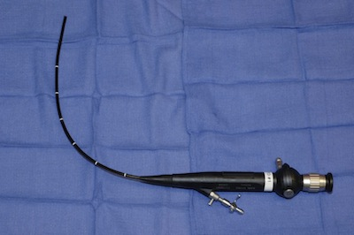
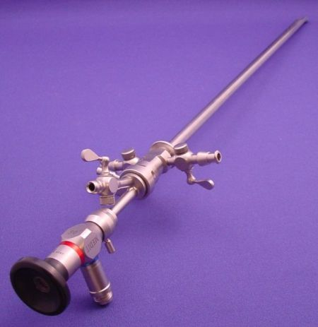
Cystoscopy
Full visualisation of the bladder, prostate and urethra
All haematuria patients aged 35 years and over
All patients with risk factors for urinary tract malignancy

Slide 38
Negative Urological Workup
Annual assessment
Creatinine / eGFR
PCR / ACR
Blood pressure
Monitor
Voiding LUTS
Macrohaematuria
Significant proteinuria
Worsening renal function
Repeat full urological work-up if persistent haematuria
Consider nephrological referral
Follow up not required
2x consecutive negative annual urinalyses

Slide 39
According to pain
Painless
IgA nephropathy
Benign familial nephropathy/ Alport’s syndrome
Exercise induced
Coagulopathy
Painful
Infection
Trauma
Malignancy

Slide 40
Haematuria with features of glomerulonephritis
Primary renal diseases
IgA nephropathy
MPGN 1 and 2
Anti GBM disease
Secondary renal diseases
Postinfectious GN
HSP nephritis
SLE

Slide 41
Haematuria - Indications for renal biopsy
Associated proteinuria
Persistent low C3
Impaired renal function
Systemic disease with proteinuria
SLE, HSP, ANCA associated vasculitis
Family history suggestive of Alport’s syndrome
Recurrent gross haematuria of unknown aetiology with extreme parental anxieties

Slide 42
INVESTIGATION
Studies performed in all patients
urine microscopy and culture
CBC
serum creatinine
serum C3 level
kidney ultrasonography
urine protein = urine albumin/creatinine ratio
calcium = urine calcium/creatinine ratio

Slide 43
Studies performed in selected patients:
Skin or throat culture
ANA titer
Urine analysis looking for cast
Coagulation study/ platelet count
Sickle cell screen
Audiogram
Renal biopsy
Microscopic haematuria plus any of the following:
Diminished renal function
Proteinuria
Persistant microscopic haematuria (>1 year)
Second episode of gross haematuria
Cystoscopy
microscopic haematuria, dysuria and sterile urine culture

Slide 44
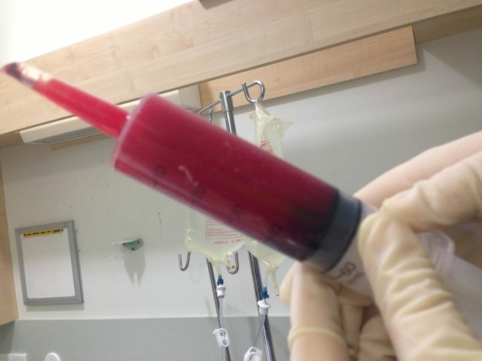
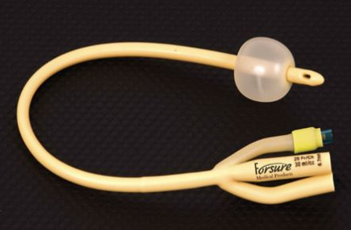
Manual Bladder Washout

Slide 45
Teşekkür Ederim

